Slide 1
Tapestry Link User Guide
Tara Floyd and Brittany Yancey,
Provider Relation Coordinators
Elizabeth Perkins, Provider Relations Manager
Proprietary & Confidential Information

Slide 2
Table of Contents
Registration and Account Settings
Enhancements
Log-In
Home Screen
Account Settings
Administrative Functions
Member Details
Selecting a Member
Member Information
Member Coverage & Benefits

Slide 3
Table of Contents-cont’d
Authorizations
Prior Auth Routing
Create Authorization
Claims
Claims by Member
Claim Search
Claim Inquiries
In Basket
In Basket - My Messages

Slide 4
ENHANCEMENTS
Enhancements: To be discussed during training
Updated coverage Detail Report for members
New claim search
New search filters for CRMs
New search feature for rejected claims

Slide 5
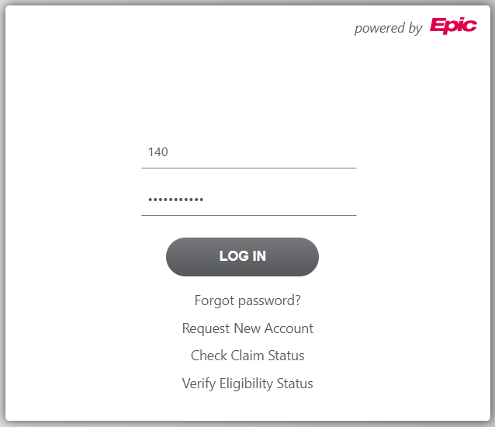
Log In
At the login screen, you will enter your Username and Password and click Log In.
Additionally, you have options to:
Reset your Password
Request a New Account
Check Claim Status
Verify Eligibility Status
username
Notes:
Check claim status – ID = Claim number, not member number

Slide 6
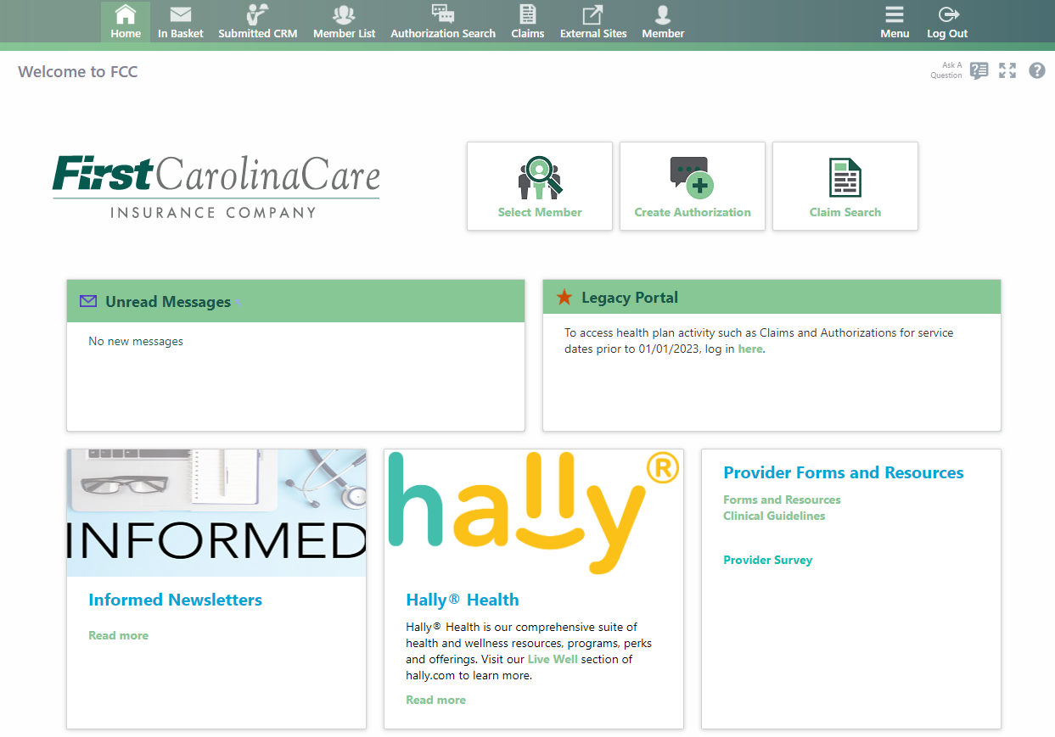
Home Screen
From the Home Screen you will see several quick access buttons as well as the full menu across the top of the screen.
Notes:
Header bar will stay at the top of every screen
Menu will give you additional options

Slide 7
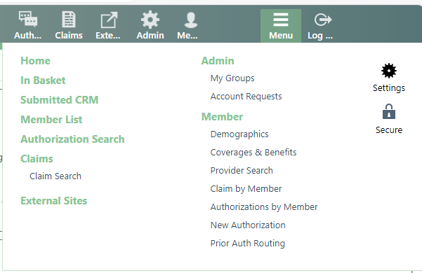
Account Settings
You may access your user settings by choosing settings under the Menu button on the home screen.
From here you may change your password, update your demographics, set your default page, and set your challenge questions.

Slide 8


Administrative Functions
If you are set up as a Site Administrator, you are responsible for maintaining the user list for your group. You may do this by opening the Admin menu at the top of the screen.
Choosing My Groups will take you to all your users. From here you may change their password by clicking the key icon.
You may also deactivate them by clicking the red line icon.
Choosing Account Requests will allow you to request access for new users. Site Administrators will create the initial passwords and advise of new credentials.

Slide 9


Selecting a Member
Choose the Select Member icon on the home screen to select a member.
Within this screen, you will have two options for searching: Search My Patients and Search All Patients.

Slide 10
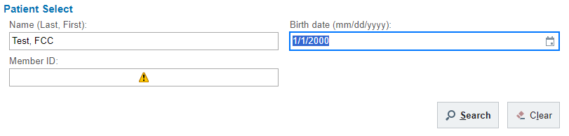
Selecting a Member – Search All Patients
In the Search All Patients screen, you will need to have at least two of the three patient identifiers in order to locate them.

Slide 11
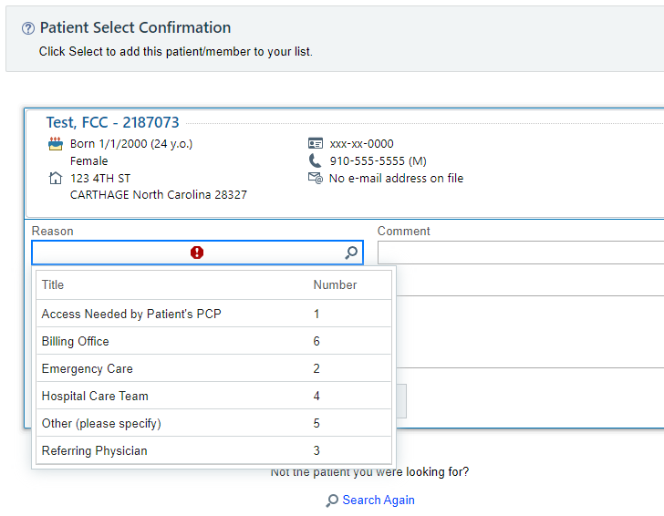
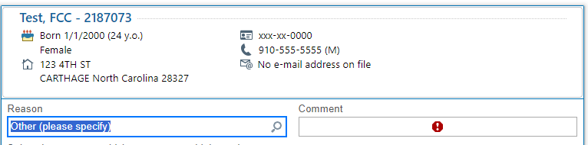
Selecting a Member – Search All Patients-cont’d
Once you have located the member,
you will then add the member to your list.
You will choose a reason in the reason
field by clicking the magnifying glass
for the available choices.
**If you choose Other (please specify) you will need to put a comment in the comment box.**
Notes:
Red stop signs indicate a required field

Slide 12
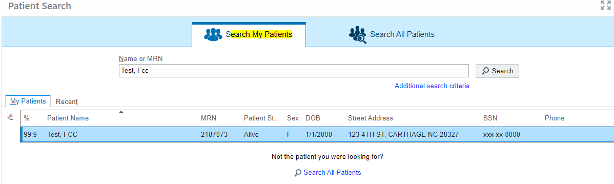
Selecting a Member – Search My Patients
The Search My Patients function will allow you to search only for the patients you have added to your list.
You may type in the patient’s name and hit search to locate them quickly and efficiently.

Slide 13
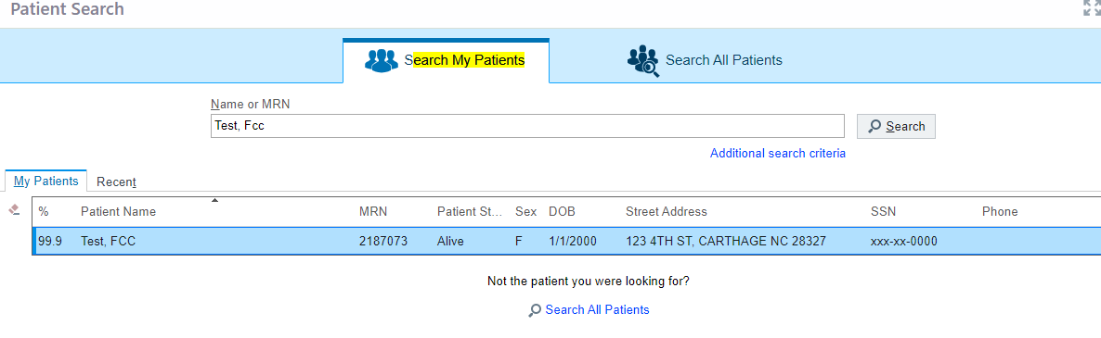
Selecting a Member – Search My Patients-cont’d
If you do not immediately locate the member you can add additional search criteria or choose to Search All Patients.

Slide 14
Member Information
Once you have chosen your member, you will now be able to see Demographics, Coverage & Benefits, Authorizations by Member, and Prior Auth Routing.
From this screen, you will also notice you are now attached to the member in the toolbar.
Choosing the … in the toolbar will give more options.
Clicking on the thumbtack will “pin” selected tab to the first position.

Slide 15
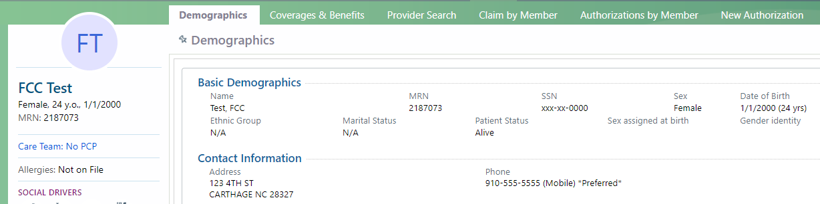
Member Information - Demographics
The Member Demographics screen will give basic demographic information about the member including; address, phone number, and PCP.

Slide 16
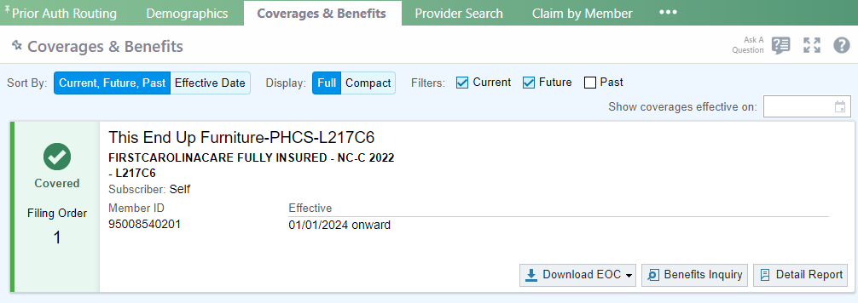
Member Coverage & Benefits
Within the Coverages & Benefits tab you will find coverage information for the member.
You can find member ID, employer group, effective date, and termination date (if applicable).

Slide 17
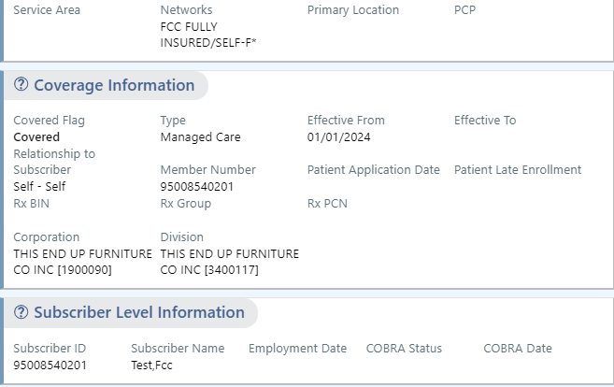
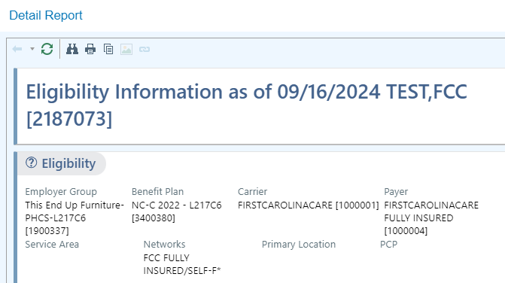
Member Coverage & Benefits-cont’d
From this screen you may click the Detail
Report option to view benefit details, including
the member’s group number
(listed as Division)
Notes:
Division Number is the member’s group number for claim submission if no ID card is available.

Slide 18
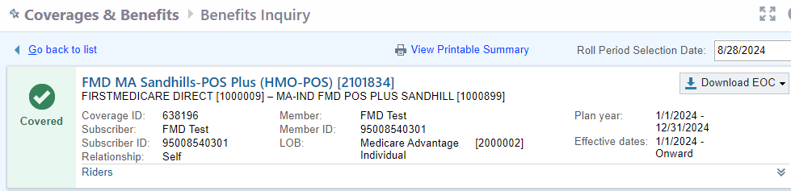
Member Coverage & Benefits-cont’d
Clicking the Benefits Inquiry option will take you to the Coverages & Benefits-Benefits Inquiry screen.
This screen will list more detailed coverage information such as subscriber, relationship to subscriber, and riders.
Notes:
Date selection field for date specific information

Slide 19
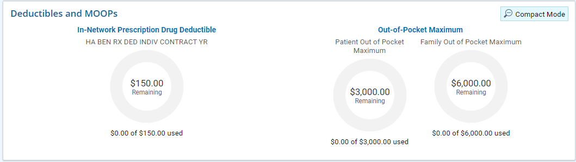
Member Coverage & Benefits-cont’d
From this screen you will also see Deductible and Out-of-Pocket Maximum amounts as well as how much has accumulated towards each.
Notes:
Clicking Compact mode shows dollar amounts only, removes graphs
Call customer service for benefits – portal may not be updated live

Slide 20
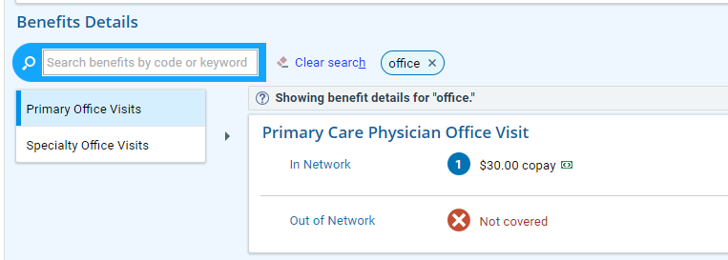
Member Coverage & Benefits-cont’d
Scrolling down this screen will list Benefit Details for the plan. You may choose the category you are searching for or type a keyword into the search box.

Slide 21
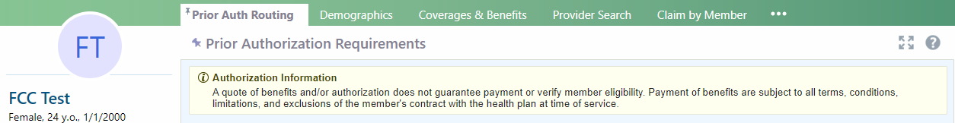
Prior Auth Routing
When attached to a member, you can request prior authorization for services by choosing the Prior Auth Routing tab in the toolbar.
Notes:
Tabs can be pinned for quicker access.
Use three dots at end to see additional options

Slide 22
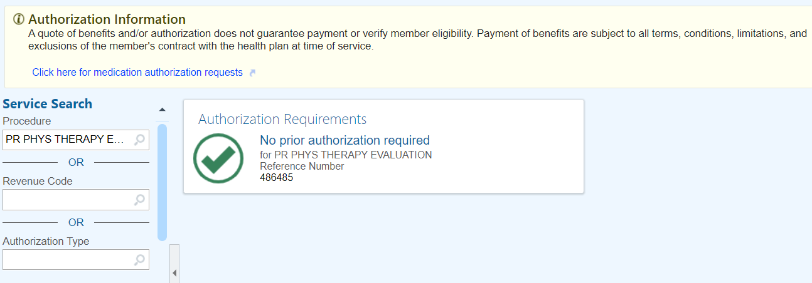
Prior Auth Routing-cont’d
Entering a Procedure code and choosing search will let you know if an authorization is needed and where to complete that authorization.
For codes that do not require authorization, it will show that No prior authorization is required.
Notes:
Do not type in description as this is not accurate.

Slide 23
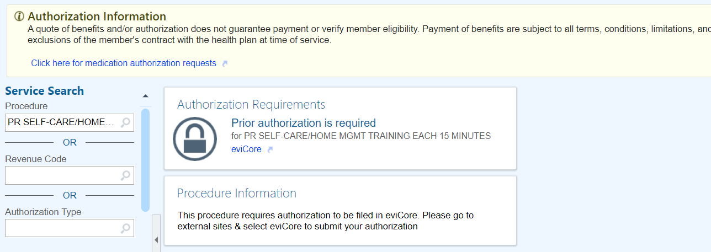
Prior Auth Routing-cont’d
If authorization is required, the hyperlink will take you to the appropriate site to complete.
Evicore
Guiding Care
Create Authorization

Slide 24
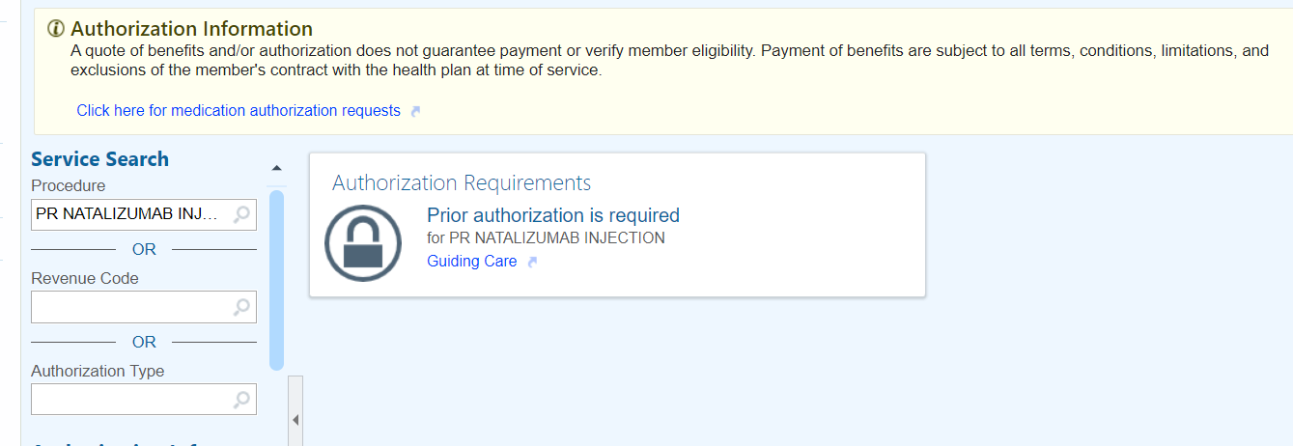
Prior Auth Routing-cont’d
For most pharmacy codes, you will be given a link to complete those authorizations in Guiding Care.
When possible, enter specific Drug code. If not available, please refer to the member’s formulary for PA requirements.

Slide 25
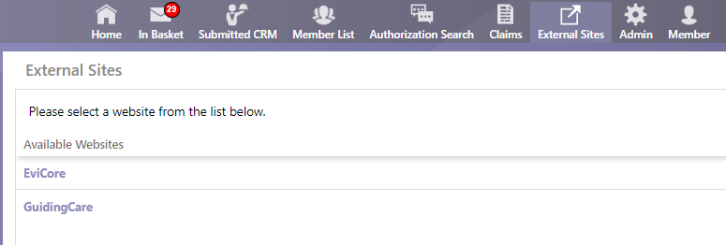
Prior Auth Routing – cont’d
You can also access Guiding Care and eviCore from the Home Screen by clicking on the External Sites icon.

Slide 26
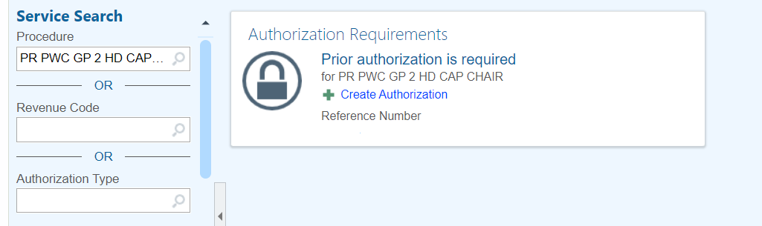
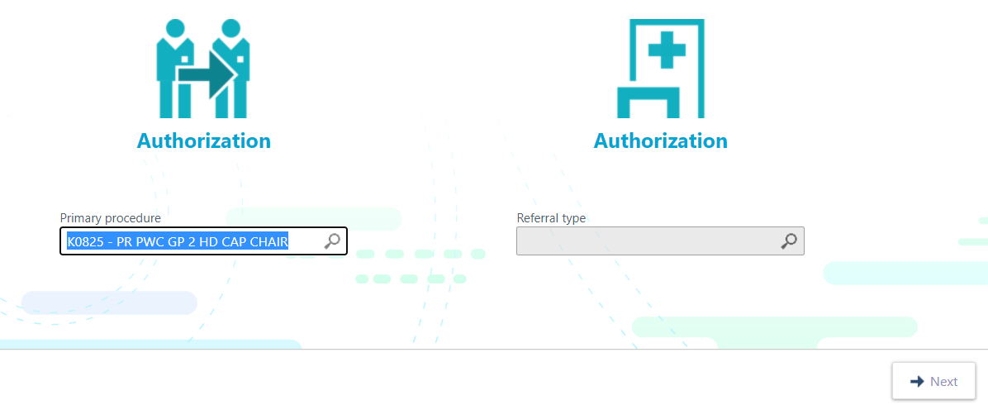
Create Authorization
After clicking Create Authorization, you will re-enter the code in the primary procedure field at the bottom of the screen and click Next.

Slide 27
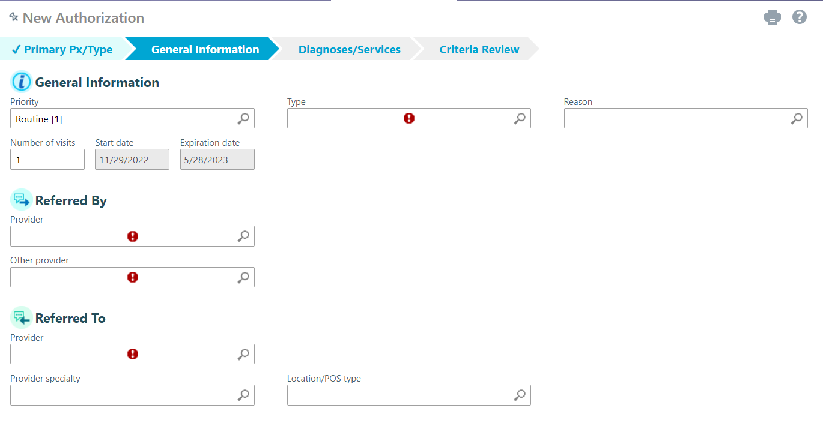
Create Authorization-cont’d
In the next screen, you will fill in all fields with a red stop sign.
Click Next when completed. If no provider found, enter “555555” in the Referred To box.
Notes:
You may search for options by typing in keywords/first few characters and use keyboard arrows or by clicking the magnifying glass in each box.

Slide 28
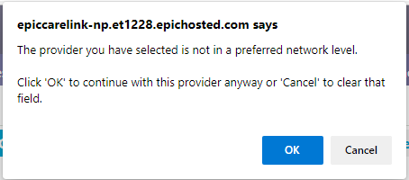
Create Authorization-cont’d
The provider you are referring to may be out of network and if so, you will receive a message box notifying you of this. You may click OK to continue to the next screen.
If it was not your intention to refer out of network, you may click cancel and return to the previous screen to find an in-network provider.

Slide 29
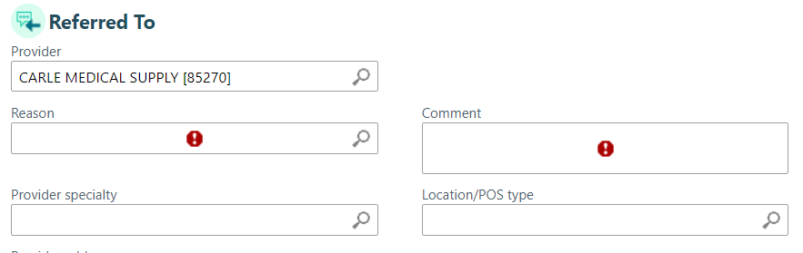
Create Authorization-cont’d
Once you have clicked Next on the previous screen, two more fields will become available underneath the Referred To section. Once these fields have been completed, click Next.

Slide 30
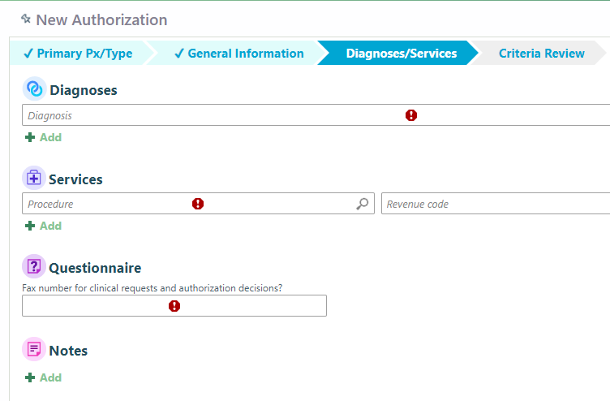
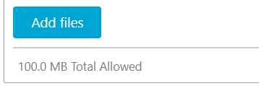
Create Authorization-cont’d
You will then enter the
diagnosis code in the
diagnoses field. You may
enter additional diagnoses or
Procedure codes by clicking the
Add icon. Please enter the clinical
fax number in the Questionnaire field.
You may choose to Attach
documentation at this
point by clicking the Add icon
under the Notes and clicking
Add File.
Notes:
Total Allowed Note size 100MB – increase from 10MB

Slide 31
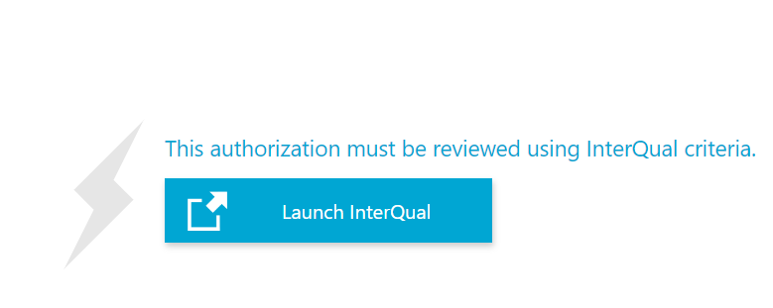
Create Authorization-cont’d
You will now receive a link that will allow you to Launch InterQual. When you click the link you will be routed to InterQual via Change Healthcare to complete the authorization.

Slide 32
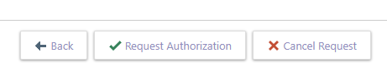
Create Authorization-cont’d
If InterQual Criteria is met, you will receive an immediate authorization approval.
If InterQual criteria was not met, you can choose Request Authorization to submit your request for review.

Slide 33
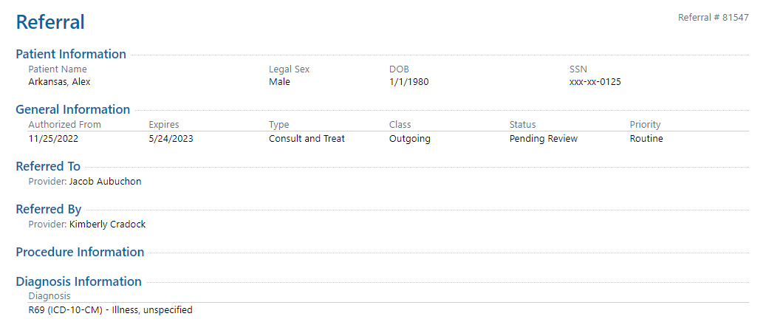
Create Authorization-cont’d
Once you have submitted the authorization, you will receive a page with authorization details. It will show referral #, status, the authorized from and to dates, diagnosis, and any comments you added to the authorization.

Slide 34
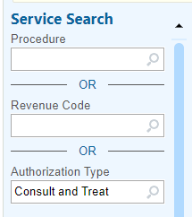
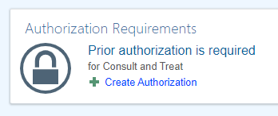
Create Authorization-cont’d
If you are wanting to refer a patient to a provider that is not listed in the patient’s preferred network, you would choose the Authorization Type Field and search for Consult and Treat. Select Create Authorization.

Slide 35
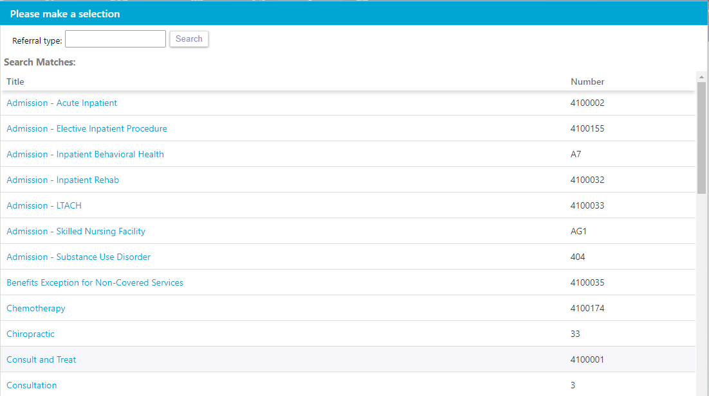

Create Authorization-cont’d
Once you have chosen Create Authorization, you will then select the referral type and choose next. Follow same process as outlined in previous slides.

Slide 36
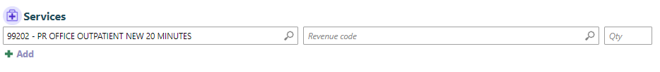
Create Authorization-cont’d
When selecting the service for Consult and Treat authorizations, you will want to enter CPT code 99202. If approved this would allow for services to be performed with the referred to physician.

Slide 37
Authorizations by Member
When you are attached to a member, you may view the authorizations that have been submitted for that member by choosing the Authorizations by Member tab in the toolbar.
In this screen you will be able to click the ID and go directly to the authorization. You can also see status at a glance.

Slide 38
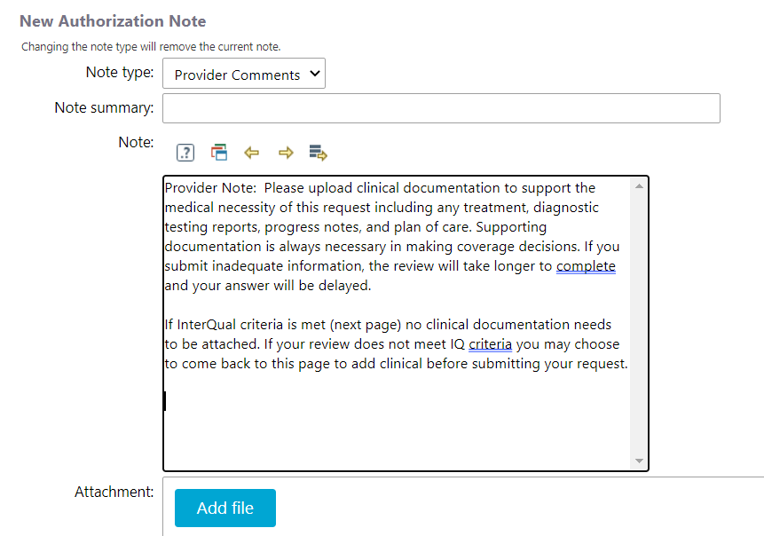
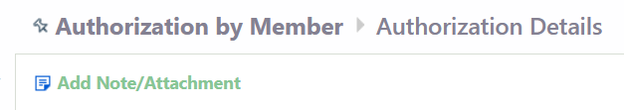
Authorizations by Member - cont’d
You can also add additional notes/attachments to an existing Authorization Request by clicking the button at the top of the Authorization Detail screen

Slide 39
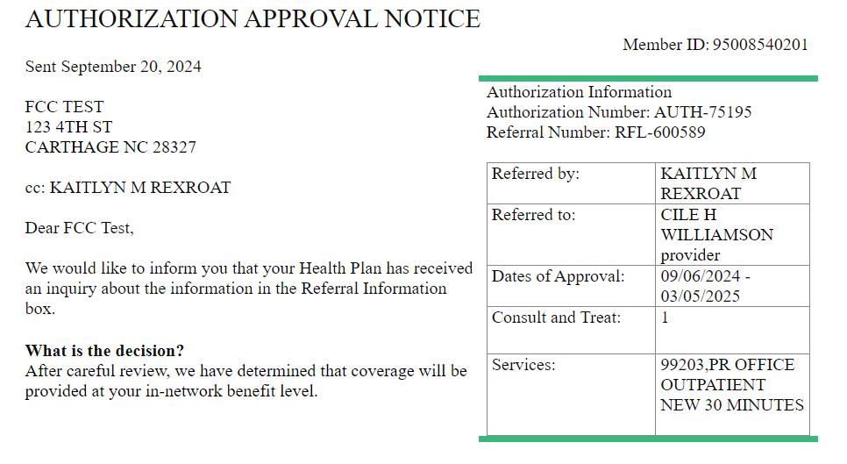
Authorization by Member-cont’d
If an authorization is approved, the notification letter will be attached to the member under the Authorizations by Member tab. By scrolling down, you will locate the letter along with the authorization number.

Slide 40
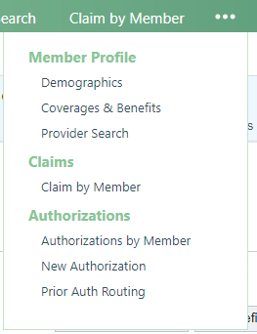
Claims by Member
When you have a member selected,
you may choose to view claims only
by that member. The Claims by
Member functionality will be within
the toolbar and you may need to
choose the … to locate this option.

Slide 41
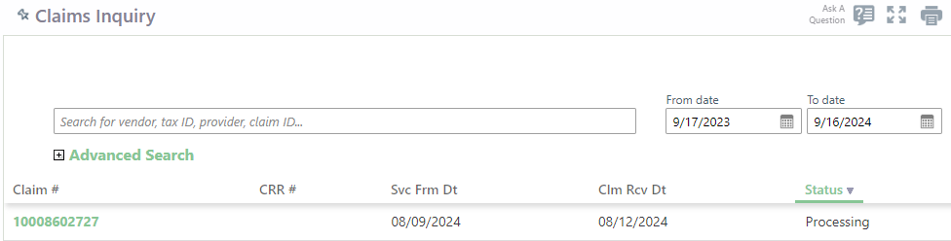
Claims by Member-cont’d
Once you have chosen to view Claims by Member, you will see a list of claims for this member based on the date range that has been selected.
You may click on the Claim # hyperlink to view the claim details.

Slide 42
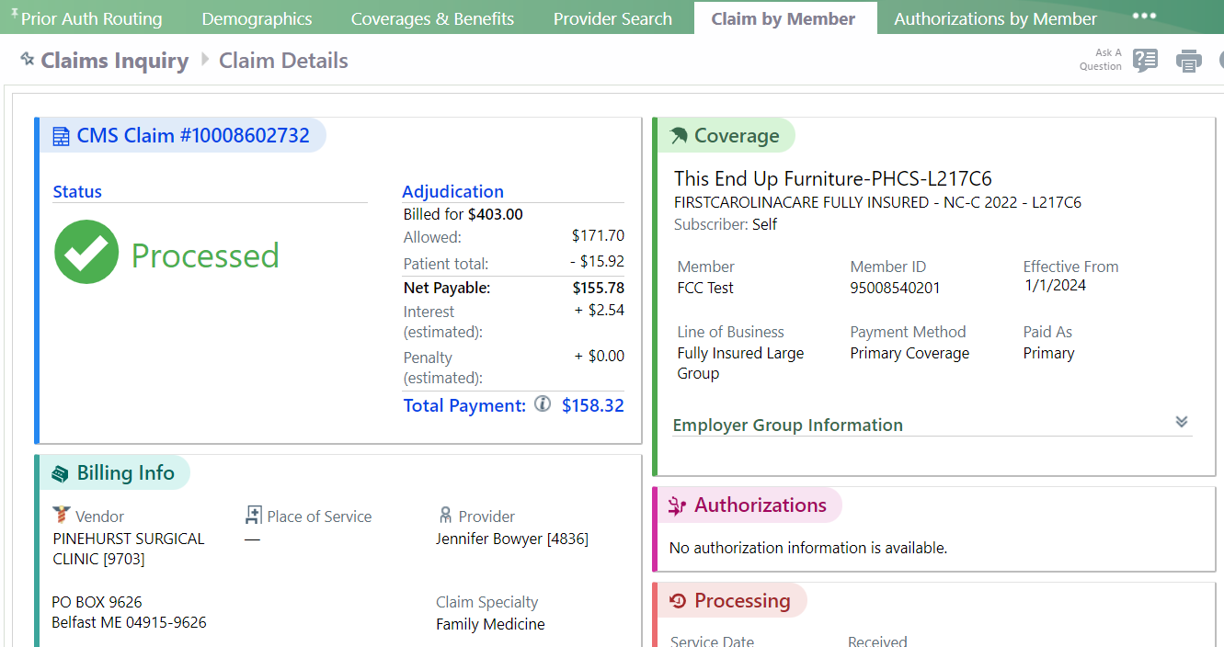
Claims by Member-cont’d
The Claim Details screen will
allow you to view more detailed
claim information for the patient
including claim status,
allowed amount and payment
details.
Notes:
Remit not available in the portal at this time, but you can access them through the Zelis website.

Slide 43
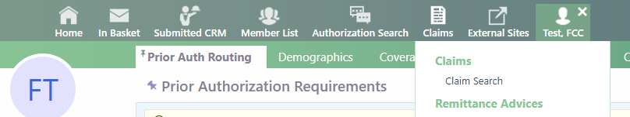
Claims Search
You may choose Claims Search from the Claims tab on the home screen in order to search for more claims with additional search options.

Slide 44
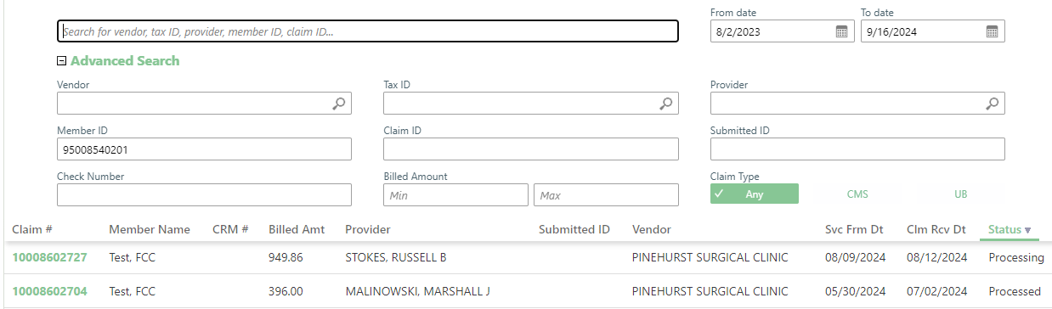
Claim Search-cont’d
From this screen you will be able to click the + icon by the Advanced Search text and it will provide a more comprehensive list of ways to search for claims.
This will allow you to pull very specific claims or a broader range of claims.
Click on the claim # hyperlink in the search results to view the claim details. All claims will show paid, processing , denied and rejected.

Slide 45
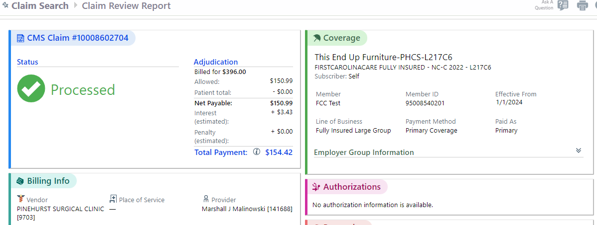
Claim Inquiries
There are multiple ways within Tapestry Link to submit a claim inquiry. The most efficient way, is to utilize the Ask a Question icon at the top of the Claim Review Report screen that shows claim details.

Slide 46
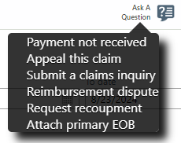
Claim Inquiries-cont’d
If you hover over the Ask a Question icon, you will get the following text box.
“Submit a claims inquiry” is for any questions you may have and “Appeal this claim” is for official appeals. This needs to be submitted within the timeframe your contract allows from the date the remit went out.
Based on the option you
choose, it will be routed to
the correct department.

Slide 47
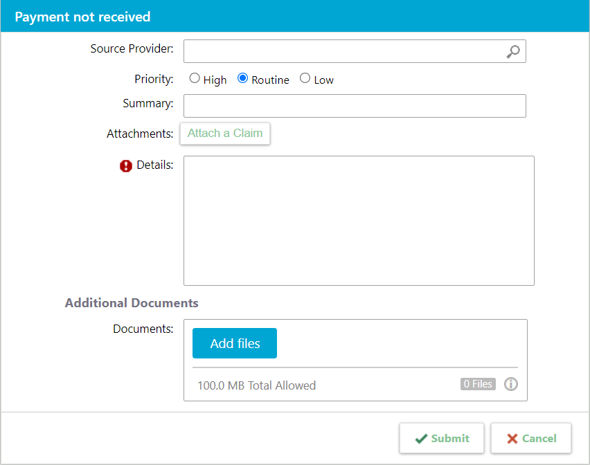
Claim Inquiries-cont’d
When you choose the option in the
Ask a Question text box, you will get
a screen that allows you to give details
related to your inquiry and attach
any documents that are pertinent.
If you have a larger
document , you will need to split
it up into multiple documents
under 100MB.

Slide 48
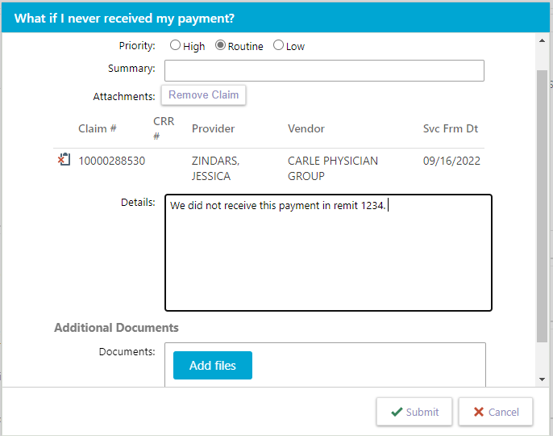
Claim Inquiries-cont’d
In this inquiry screen, you will also notice the claim you are currently viewing is attached to the inquiry you are sending so you will not need to reference the claim number as it is already listed.

Slide 49


Claim Inquiries-cont’d
Once you have submitted your inquiry, you will receive a pop-up indicating that the message has been sent successfully.
You will also receive a notification in your In Basket with a confirmation that your message has been received.

Slide 50
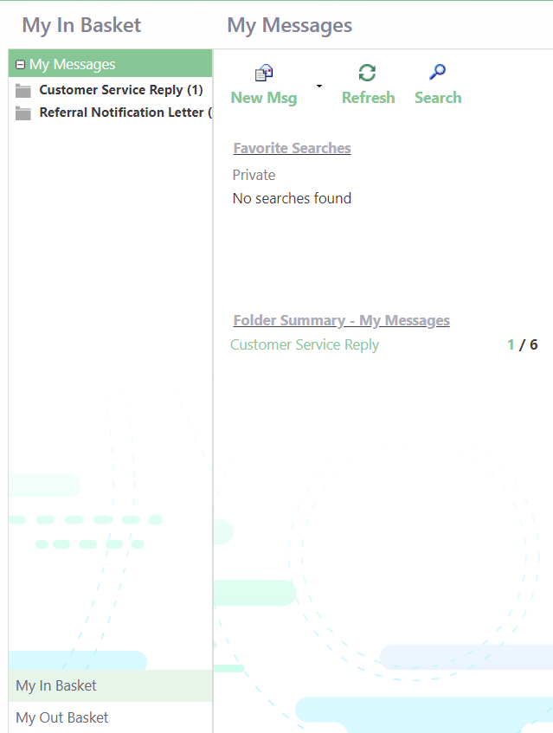
In Basket – My Messages
Clicking on the In Basket icon in your toolbar will take you to your In Basket.
This is where you will find messages sent to you as well as messages you have sent.

Slide 51

In Basket – My Messages – cont’d
In your In Basket screen, you will have an area that is titled My Messages.
Here you will find your Folder Summary, which shows messages sent to you. The first bolded number is the number of unread messages and the second number is the total number of messages in your in basket.
Clicking the bold number
will take you directly to the unread messages.

Slide 52
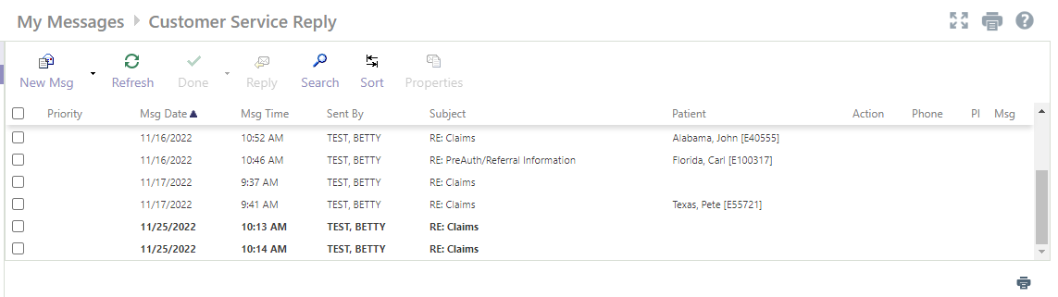
In Basket – My Messages – cont’d
In the My Messages-Customer Service Reply screen, you will see all messages you have received from Customer Service.
You may sort this screen by any of the columns in this area.

Slide 53

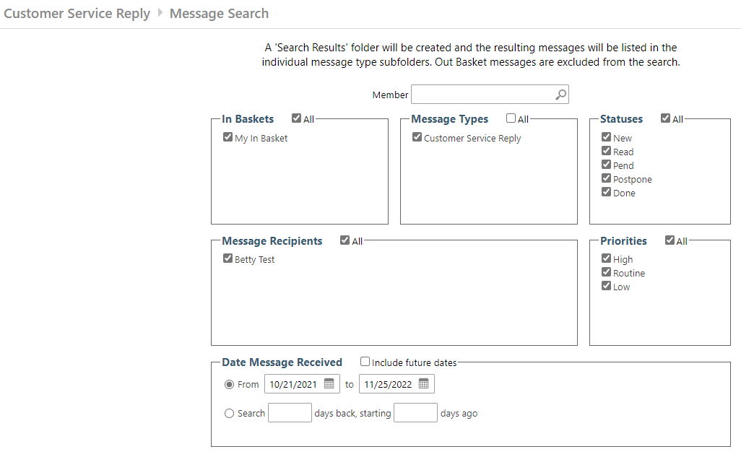
In Basket – My Messages – cont’d
You may also search within this screen by using the Search icon in the toolbar.
This will give many options for searching your messages, including by member.

Slide 54
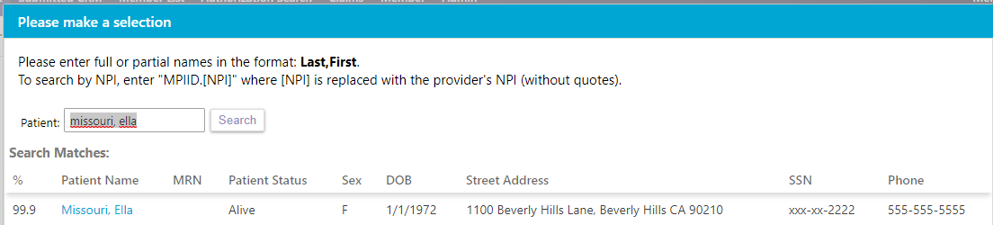
In Basket – My Messages – cont’d
By choosing to search by member, you will be asked for the patient’s name. You will then be able to choose the patient from the Search Matches.

Slide 55

In Basket – My Messages – cont’d
Once you have selected the member, you will then click search and you will receive all messages related to that particular member.

Slide 56

In Basket – My Messages – cont’d
To go back to all Customer Service Reply messages, you will need to highlight Ad Hoc and choose the Close icon on the associated screen.
Notes:
Ad-Hoc = custom search results

Slide 57

In Basket – My Messages – cont’d
From the My Messages-Customer Service Reply screen you may send a message directly to Customer Service. This is the preferred method of communication in Tapestry Link and will obtain the quickest results.
Choose Customer Service under New Msg to begin the communication.

Slide 58

In Basket – My Messages – cont’d
Once you have initiated a Customer Service Request, you will be required to choose from a list of topics in this screen.
Please choose the option that is
closest to what you are inquiring
about. For example, choose Claims
for a claims question.

Slide 59

In Basket – My Messages – cont’d
From here you will choose the Topic and Subtopic for your request.
In
For both, please choose the option that best suits the inquiry.

Slide 60

In Basket – My Messages – cont’d
While in the New Customer Service Request screen you will note that you are attached to the member that you were originally attached to in the toolbar at the top of your screen. If this is not the intended member, you would need to choose the Change option to choose a different member.

Slide 61

In Basket – My Messages – cont’d
Within the New Customer Service Request, you may choose to Attach a Claim by choosing the Attach a Claim function.
You will then see claims for the member you are attached to. From that screen you may choose the claim you wish to attach.

Slide 62


In Basket – My Messages – cont’d
You will be required to add details related to the inquiry. Please be as specific as possible.
You may also attach additional supporting documents if applicable.

Slide 63

In Basket – My Messages – cont’d
When you are in your Out Basket, you will be able to see all the Customer Service messages you have sent under the Folder Summary-Sent Messages area.

Slide 64
QUESTIONS
COMMENTS

